Slide 1
Automatic Lens Smear Detection
Group member:
Xinyi Chen, Shengjie Xue, Xuan Ding, Liangji Wang

Slide 2
Problem statement
For this homework, we need to detect the lens smear.
We will take a sequence of street view images as input and output a mask of the smear on the lens via our own approaches.
We finally apply 2 different approaches to deal with this problem.

Slide 3
Approach 1: subtraction, addition, and edge detection
Basic Idea:
Since the smears is fixed on the lens of camera, we can try to find those fixed areas on the image, which are most likely to be the polluted.
Thus, we convert those images to grayscale first, then we do some processing. Finally we convert the result image to binary version for better looking.

Slide 4
Detail steps:
Convert image to grayscale
Get the subtraction of each image and its previous one
Add all subtractions to one image for distinguishing the fixed areas
Do edge detection on this result image
Do erode and dilate to fill the fixed area.
Convert the result to binary image and this is the final mask

Slide 5
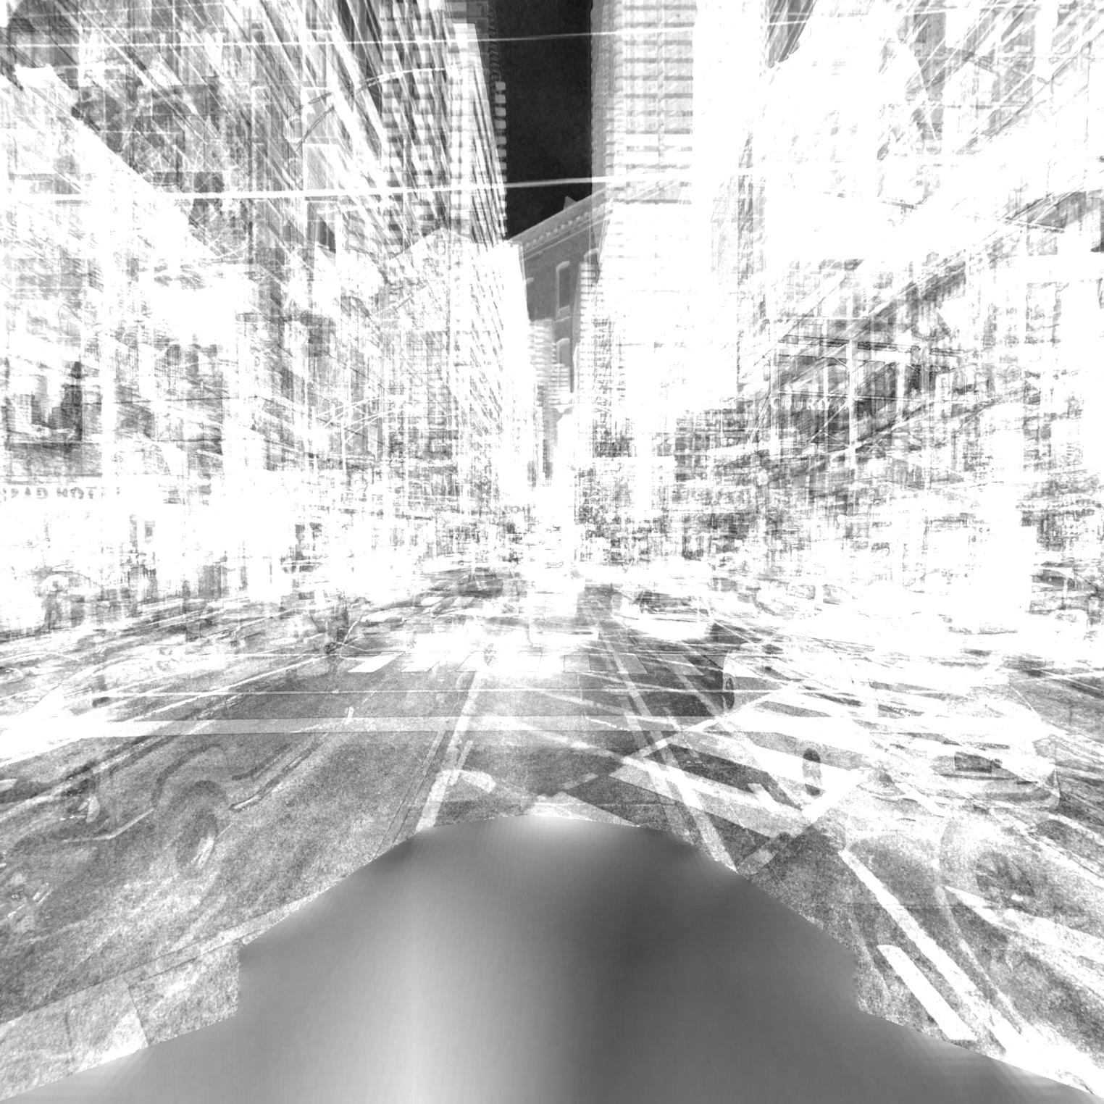
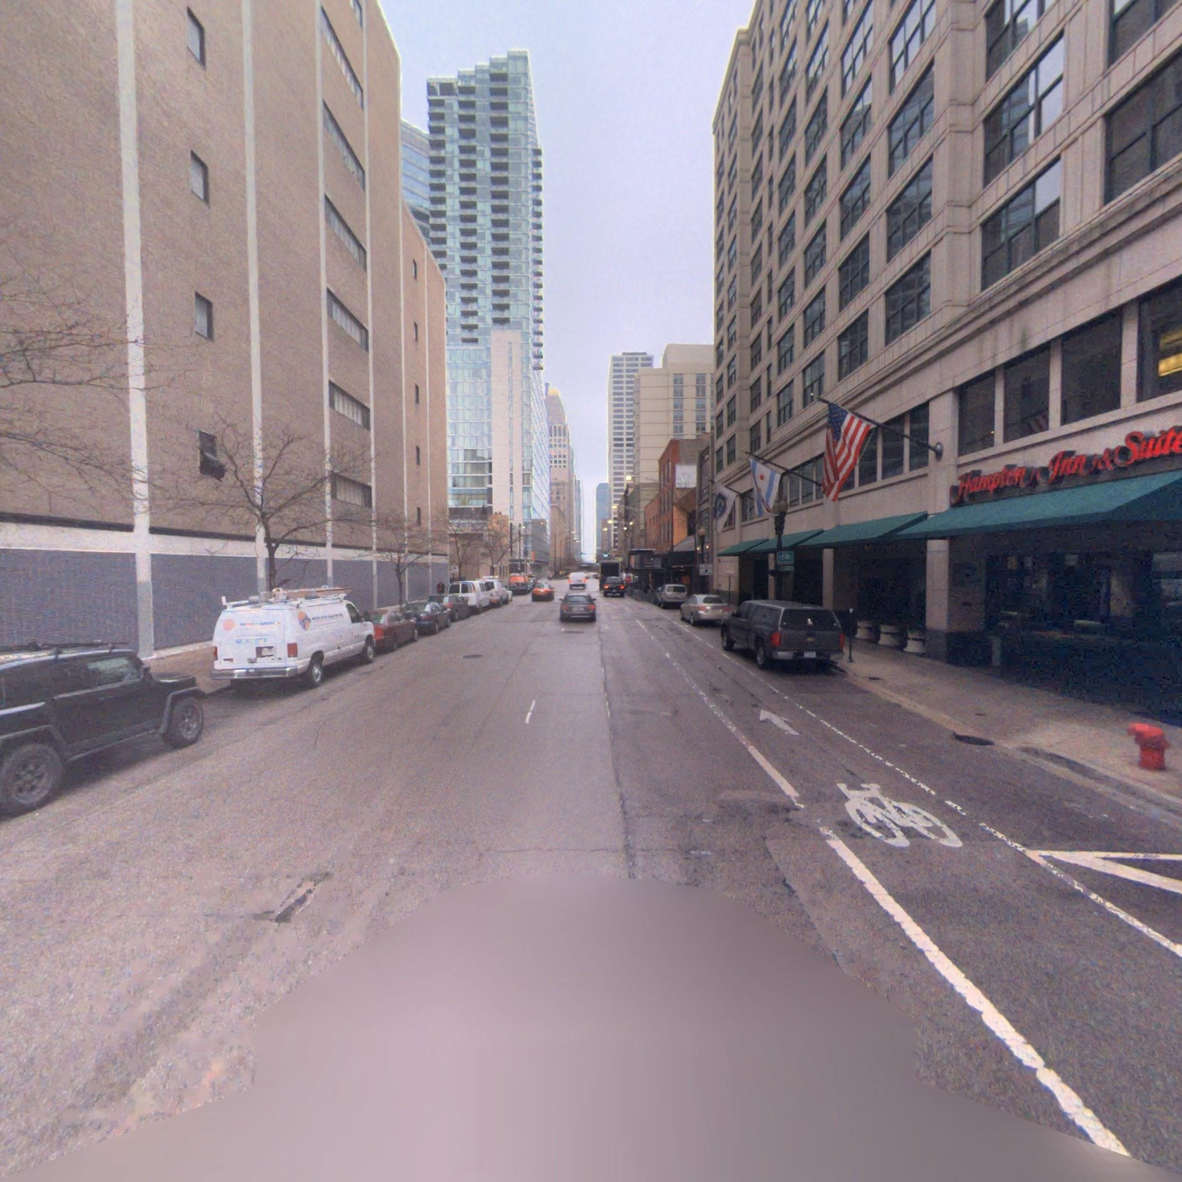
Example: image at step 3 compare to the original

Slide 6
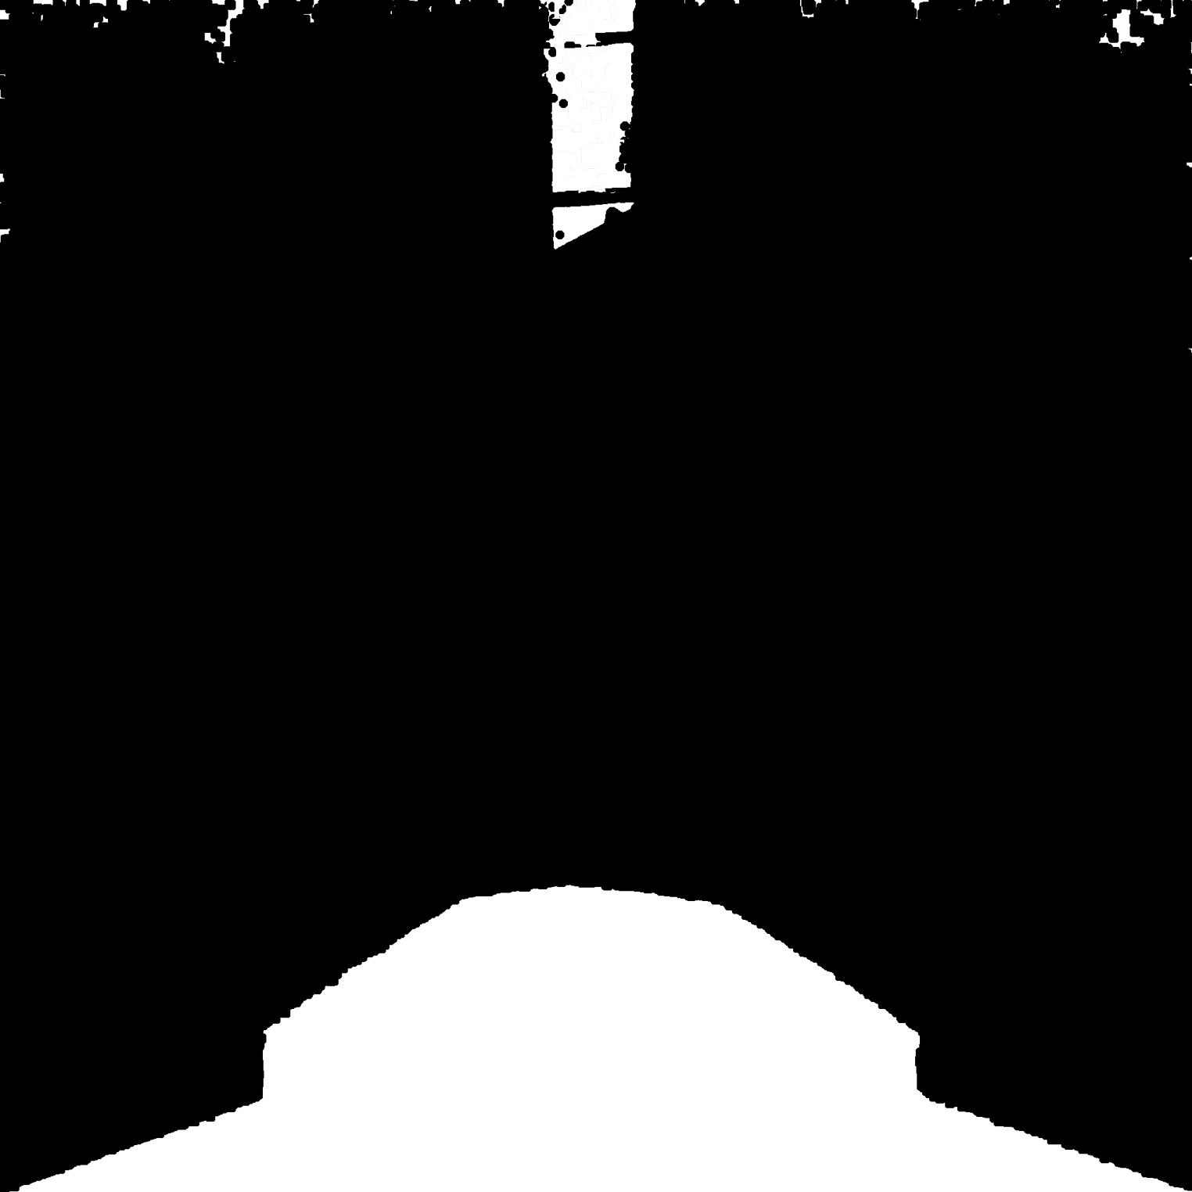
Final Result and origin

Slide 7
Conclusion
The approach 1 has a good result for this example image. The accuracy can even increase if we have enough image with the same polluted camera lens. In addition, the processing time is short. This approach is simple and efficient.
However, there are some significant bottleneck for this easy approach. First, we need a large amount of images for a better result. Besides, from the final result we can easily figure out there is a misunderstanding area at the top. The reason is that this method can only distinguish the fixed area. If the subject has only minor changes, which cause the subtraction not working, this approach will regard most parts of the image as fixed.

Slide 8
Approach 2: Image Formation Model
Basic Idea:
This approach is still based on the fixed smear area.
If we overlap enough pictures, the polluted area will be significant comparing to other parts.
Thus, we apply the ideas from the paper “Removing Image Artifacts Due to Dirty Camera Lenses and Thin Occluders”, which is based on artifact removal without calibration and do some minor modification for workability.

Slide 9
Detail steps:
Overlap some images, and take the average value of the radiance to generate a new image, which as Avg(I)
We model Avg(I) as a bivariate polynomial, and get Avg(I_zero)
Pick those pixels “whose residuals are within a threshold” of 10%
Perform the least-square fitting around 15 iteration

Slide 10
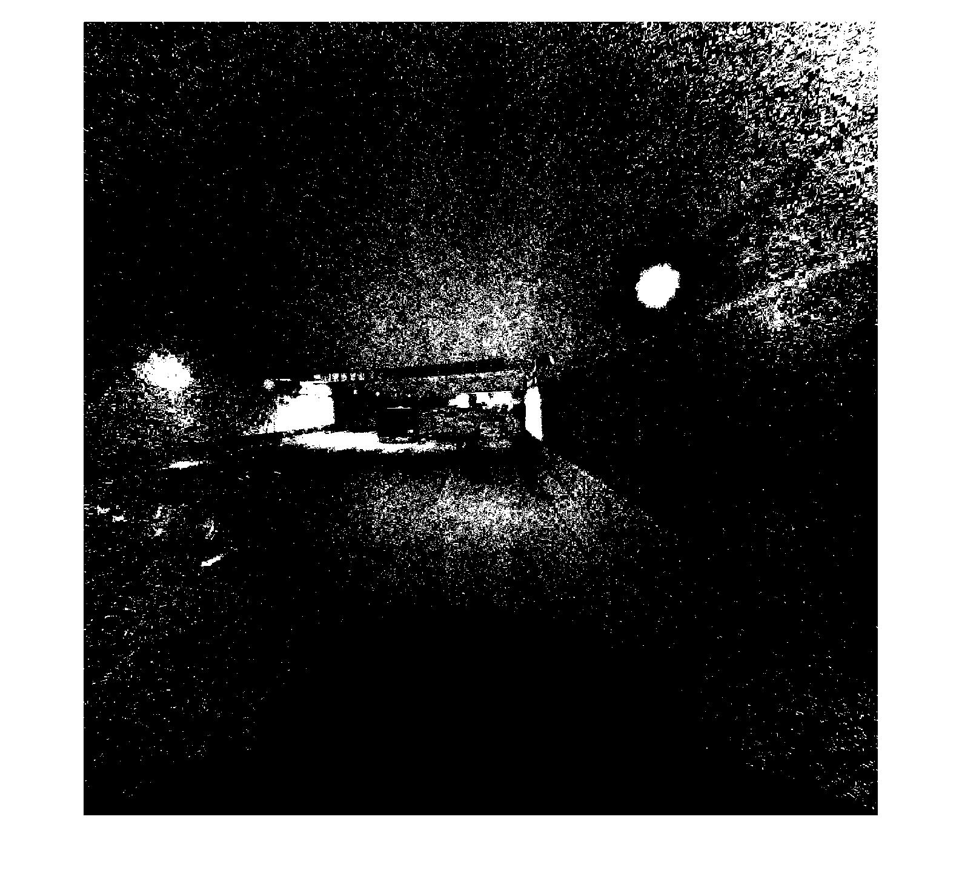
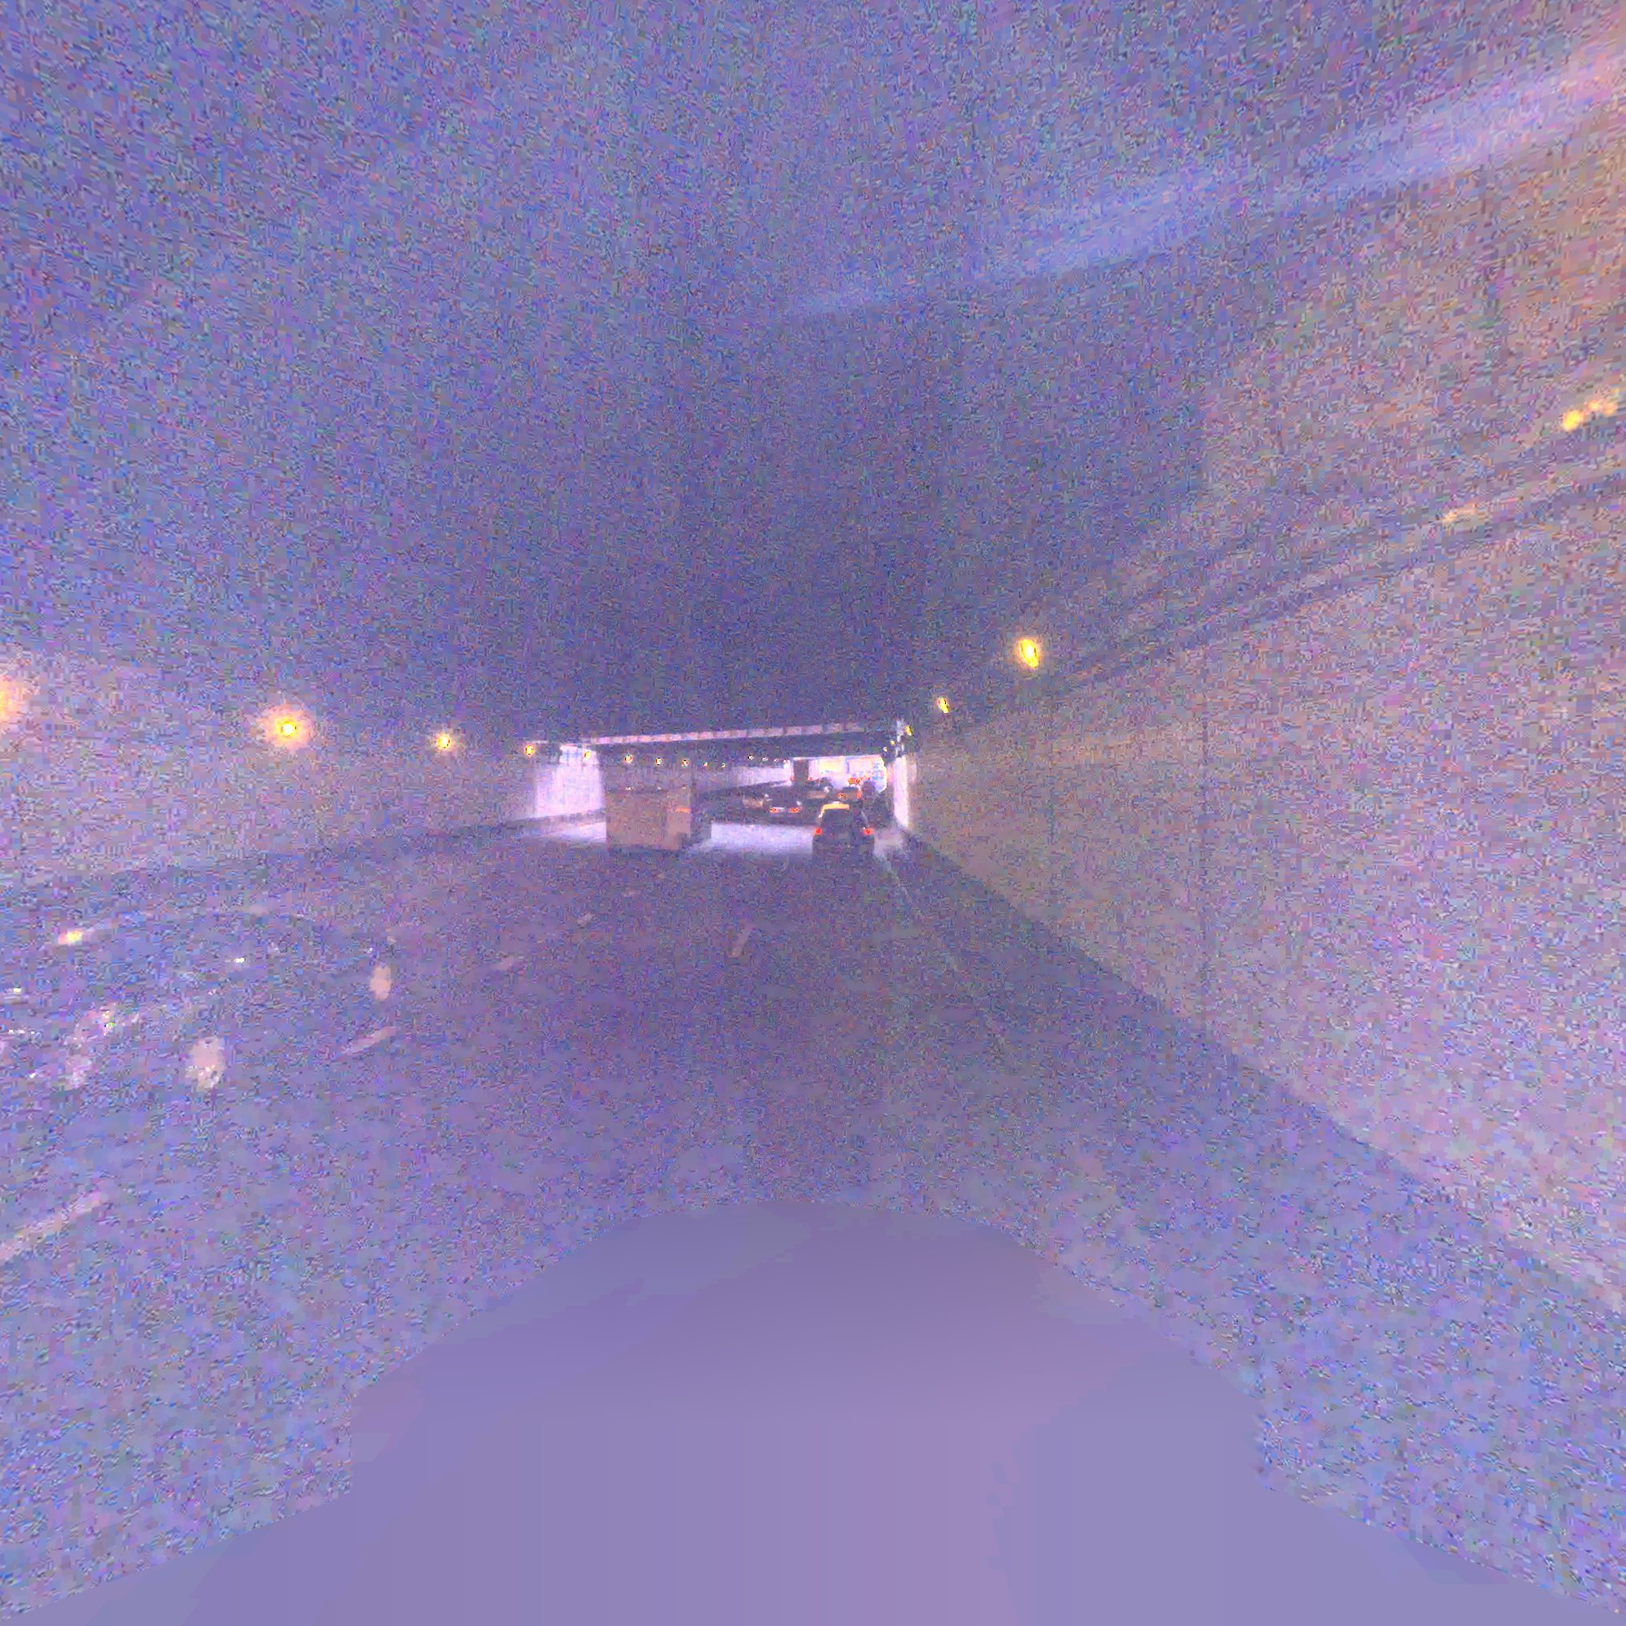
Example: avg(I_zero) and origin

Slide 11
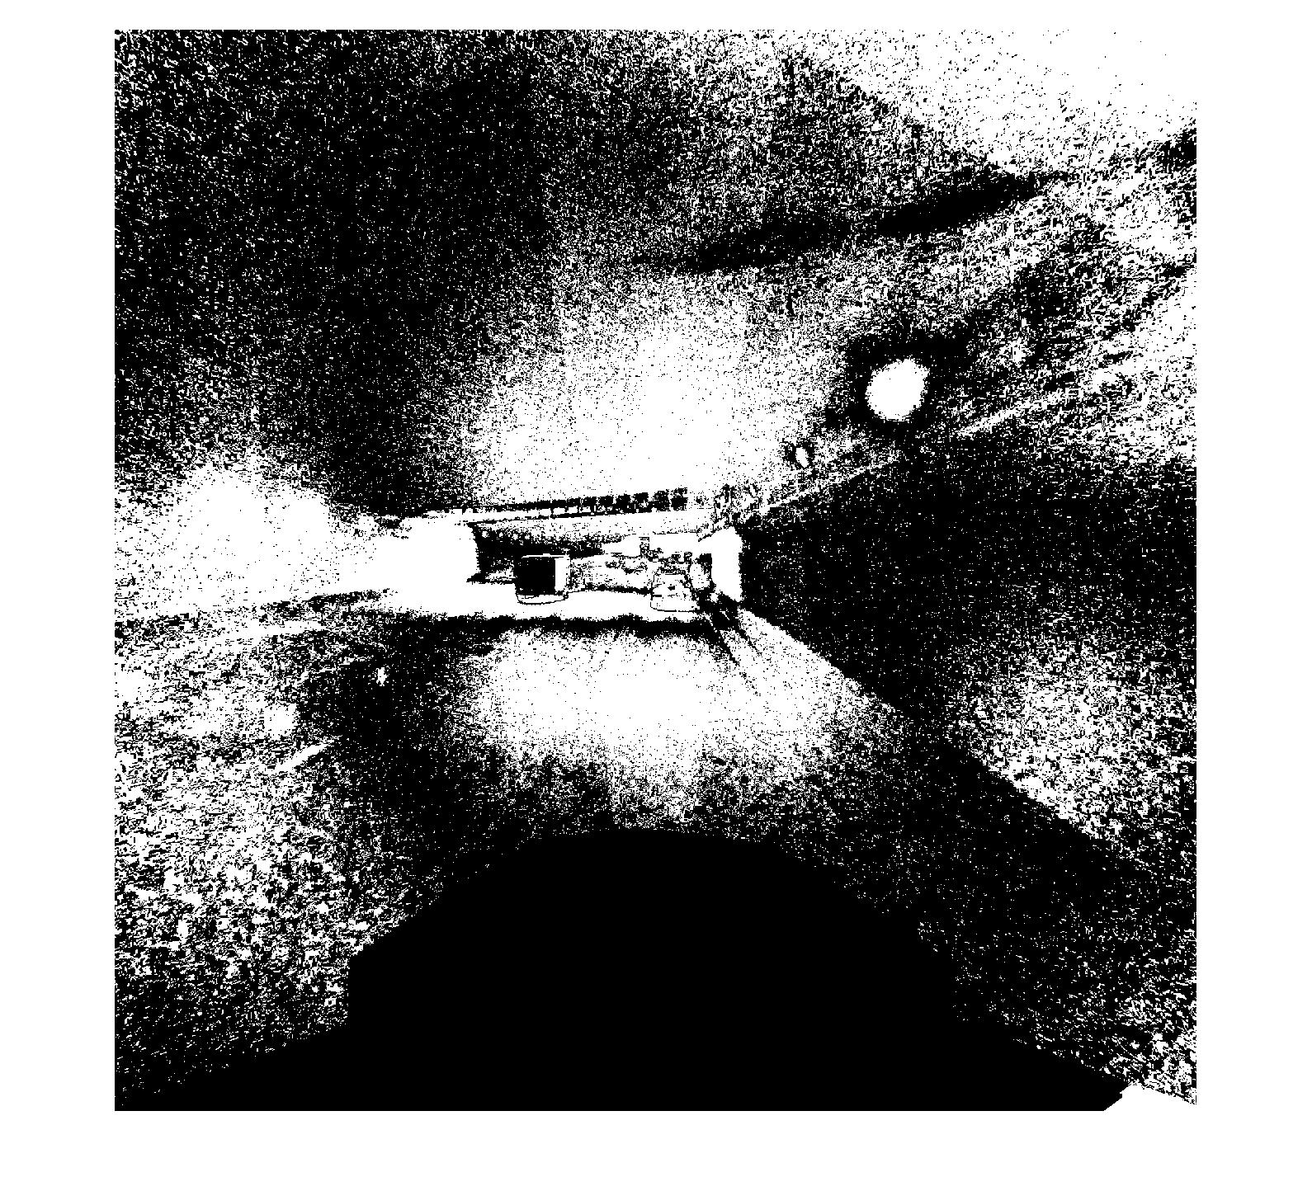
in iteration and origin

Slide 12
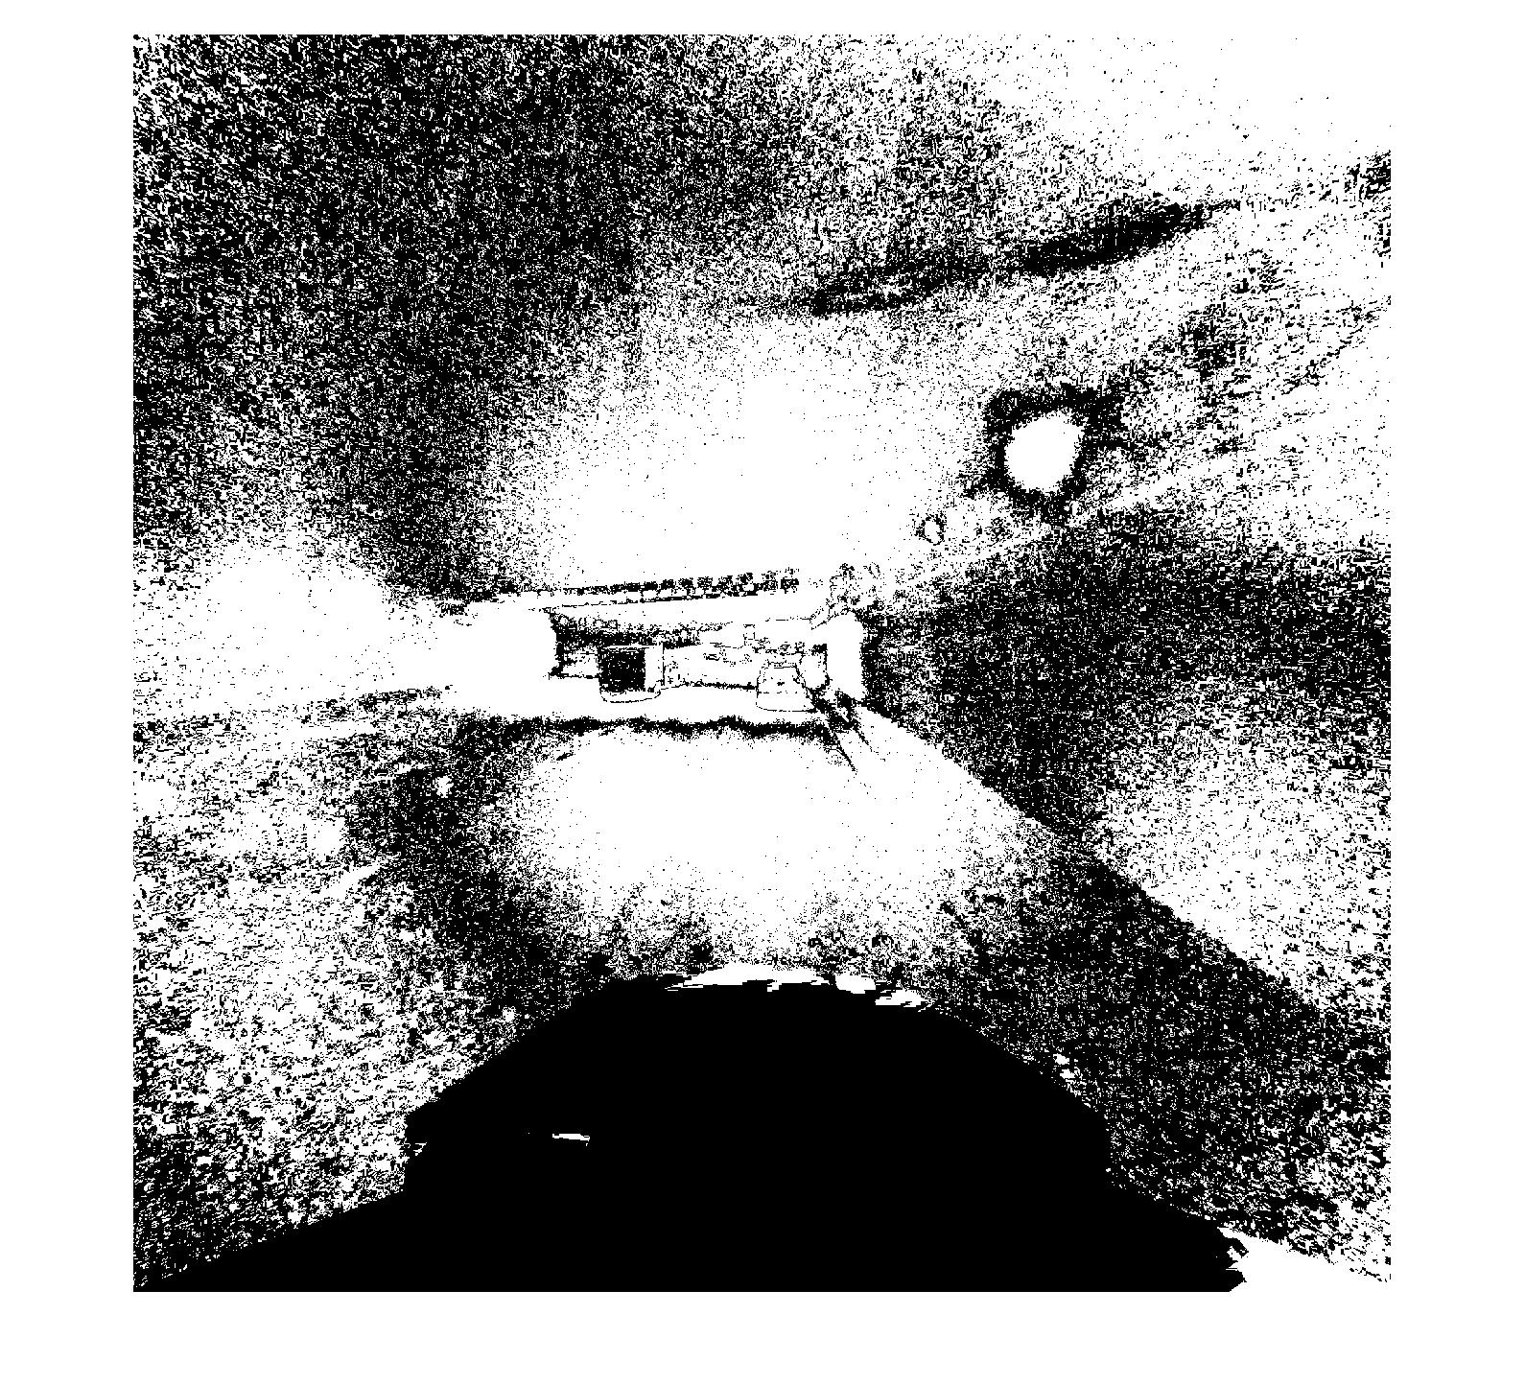
Final result and origin

Slide 13
Conclusion
This method has high accuracy and is sensitive for minor difference. Besides, it does not need many images and still can get an acceptable result.
However, this process requires sufficient time. In addition, this detection cannot get good performance when the smear is discrete distributed.

